Slide 1
deep learning-based SKIN DISEASES PREDICTION system
GROUP MEMBERS SUPERVISORS
HAFSA FAROOQI_051 MS. SIDRA EJAZ
SADIA AZAM_039 MS. SOBIA KHALID

Slide 2
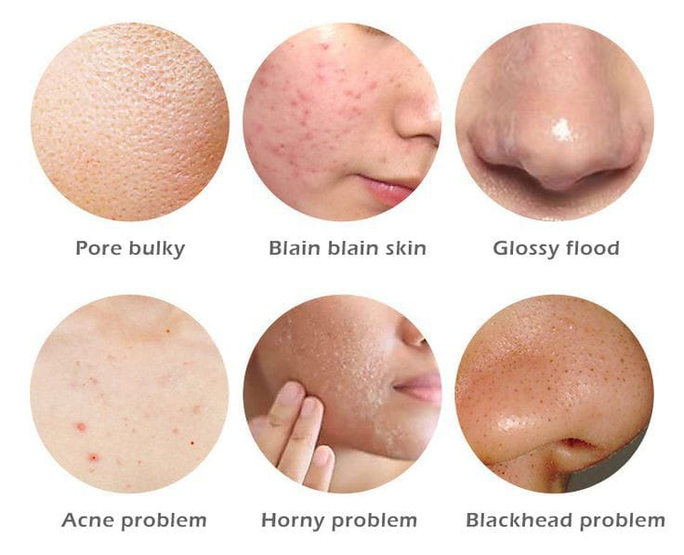
Introduction
Skin disease is a major problem among people worldwide
Our project proposes a skin disease detection method based on image processing and machine learning techniques
An image of skin disease from the dataset is provided to the system as input, and then image processing and machine learning techniques process it and deliver the accurate output
Fig 1 . Common type of skin diseases

Slide 3
Aims and objectives
Aim:
To create a system that predicts skin-related diseases
Objectives:
1. Search the dataset required to train the model
2. Pre-process the data to remove the noise elements. So the final images to train are in a
suitable format
3. Select an optimum model of deep learning
4. Train the model
5. Test the trained model based on the evaluation parameters
6. Design the interface in which we will give input images, and as a result, get the trained model
7. Finally, evaluate the interface according to non-functional requirements

Slide 4
Dataset Description
Our data consists of images of different types of skin diseases taken from the public portal
“Dermnet” which is the largest dermatology source online
We have selected ten most commonly occurring skin disease categories that include:
1. Acne and Rosacea 6. Actinic Keratosis
2. Atopic Dermatitis 7. Eczema
3. Hair Loss (Alopecia) 8. Melonama
4. Psoriasis 9. Seborrheic Keratosis
5. Tinea Ringworm 10. Hives

Slide 5
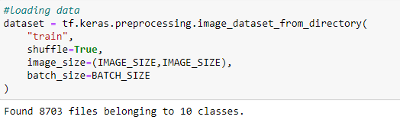
Backend System
1. Loading the Dataset

Slide 6
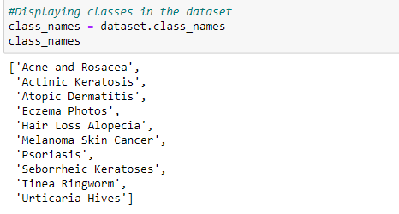
Backend System
2. Displaying classes of diseases

Slide 7
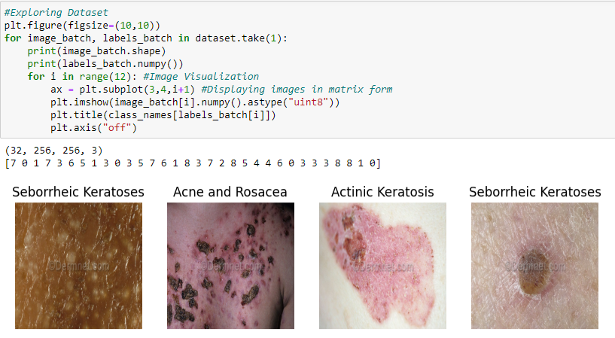
Backend System
3. Exploring Dataset

Slide 8
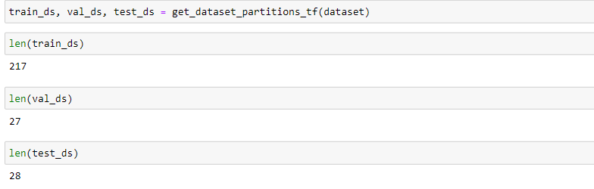
Backend System
4. Specifying Training, Validation and Testing Data

Slide 9
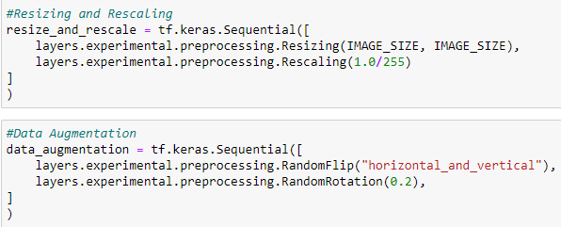
Backend System
5. Data Cleaning processes

Slide 10
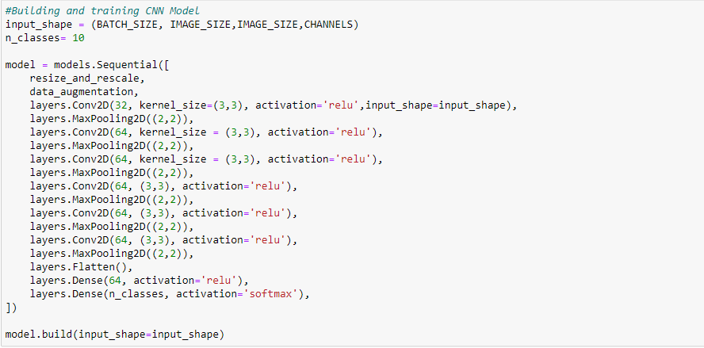
Backend System
6. Building a Convolutionel Neural Network

Slide 11
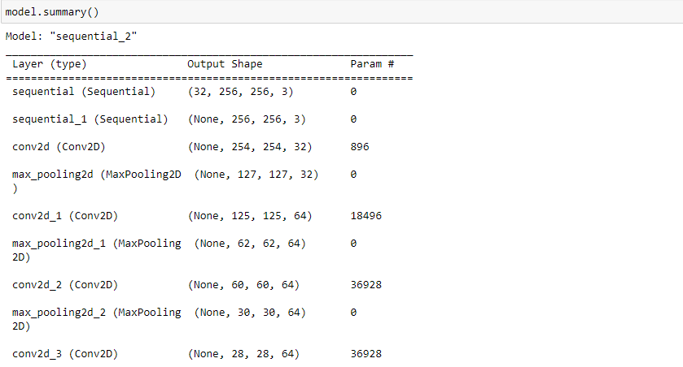
Backend System
7. Model Summary

Slide 12
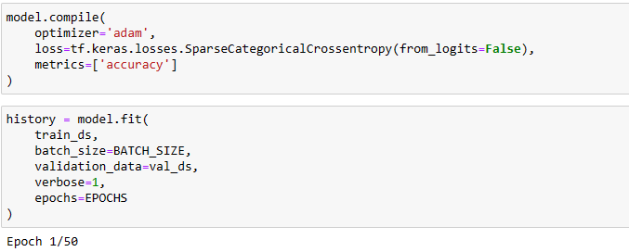
Backend System
8. Training Model

Slide 13
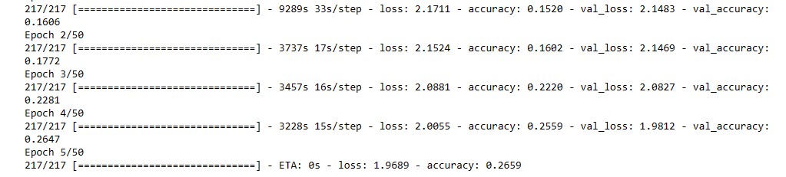
Backend System
8. Training Model

Slide 14
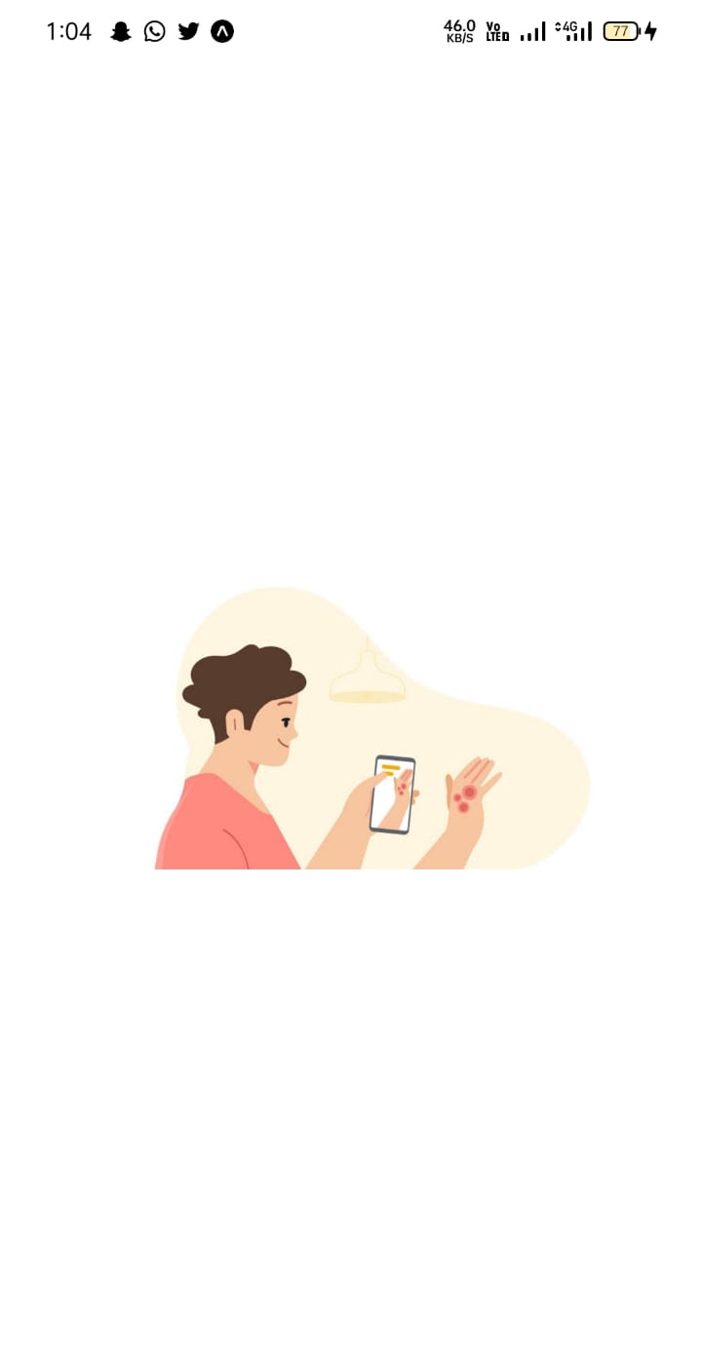
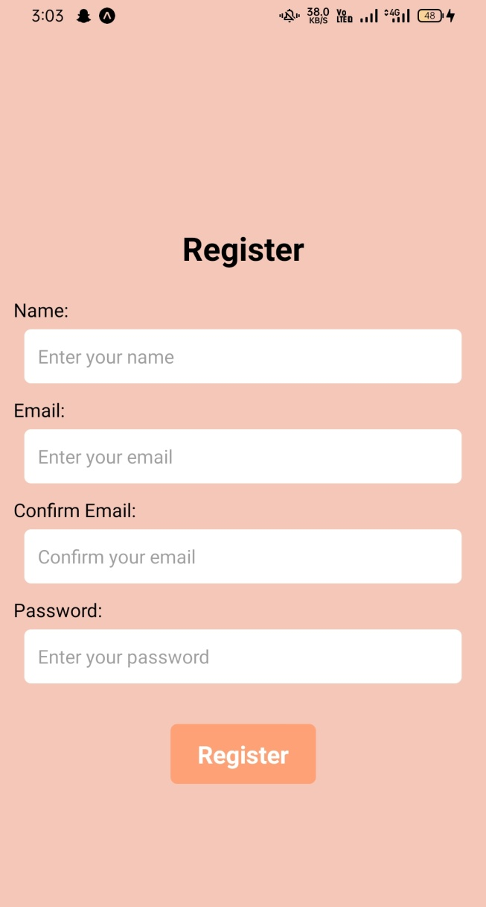
Frontend System
User has to register by entering Name,
Email and Password as soon as he/she
opens the application for the very
first time

Slide 15
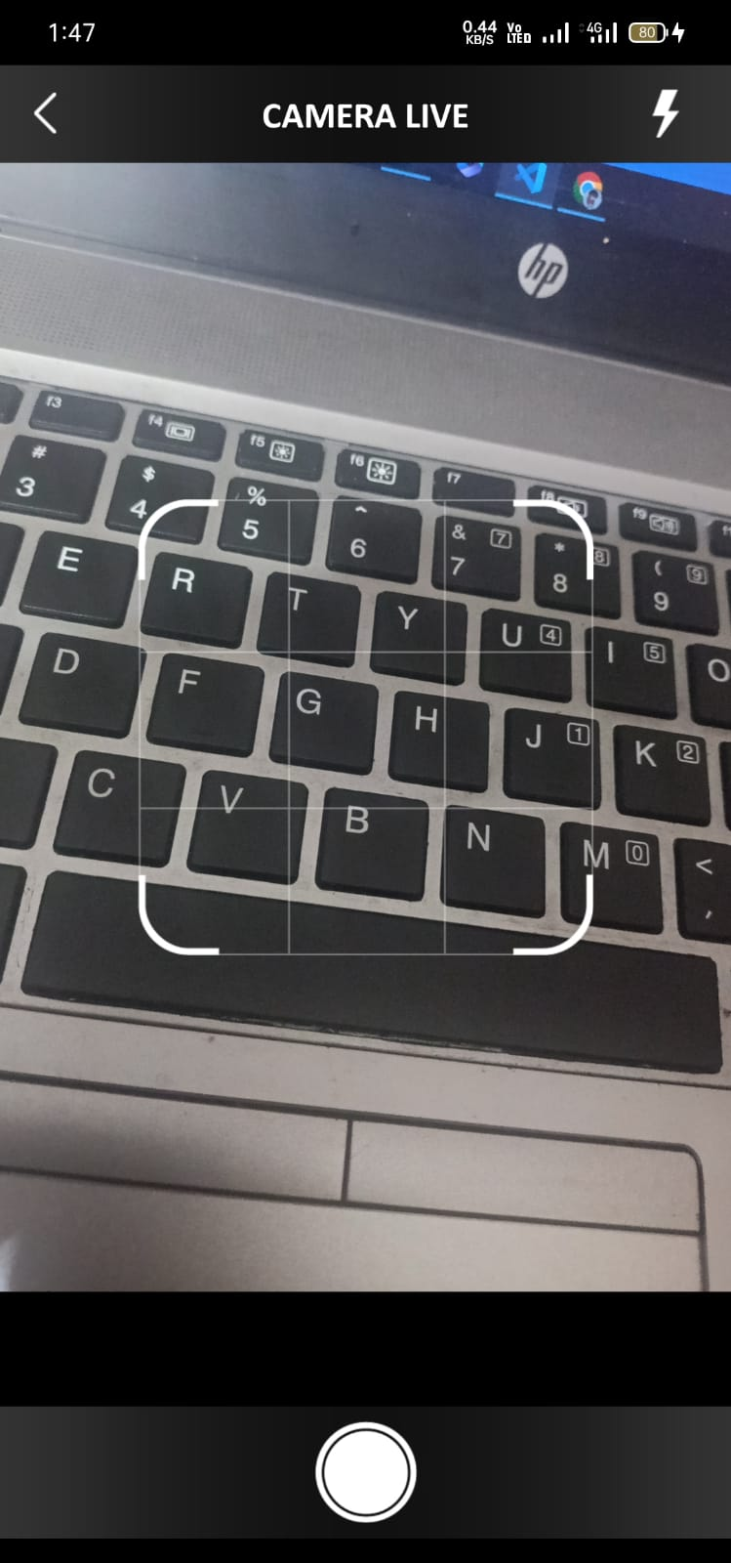
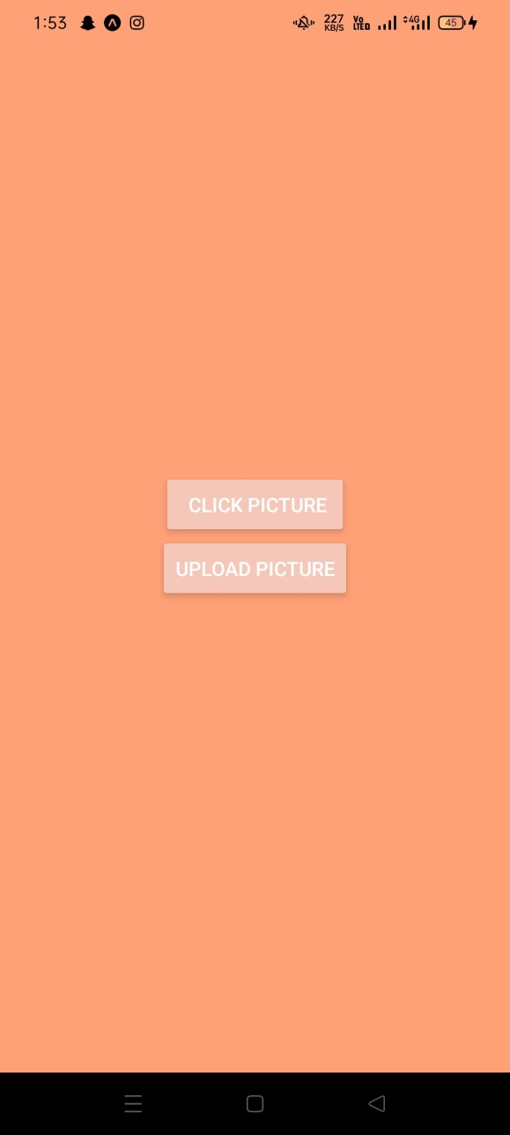
Frontend System
After registering there are two options:
1. Click Picture
2. Upload Picture
User can click picture the disease area directly
from the application or upload it from the device

Slide 16
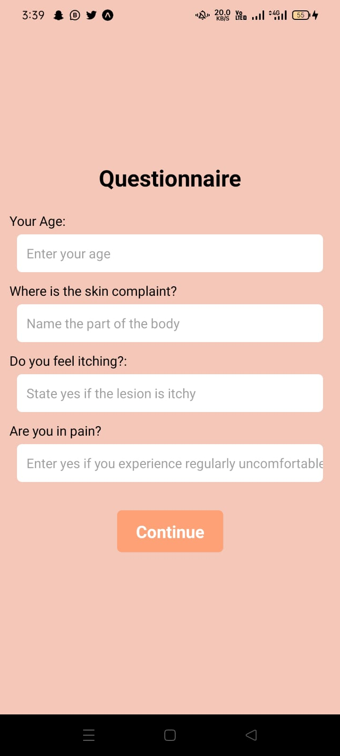
Frontend System
After submitting the picture, User have to fill a questionnaire with
several questions related to their disease for more accurate prediction,
Finally user will receive the output in the form of their disease name

Slide 17
Thank you!

